Slide 1

NICHD Strategic Plan: Overview
Guides NICHD’s research activities for the
next 5 years
Supports NICHD’s new mission and vision statements
Addresses 5 broad research themes and cross-cutting topics, such as global health
Lays out NICHD research goals and objectives as well as aspirational goals to drive future activities
Reaffirms NICHD’s commitment to research aimed at improving the health and well-being of women, children, and people with disabilities
Available at: https://www.nichd.nih.gov/about/org/strategicplan.
Notes:
Notes for presenters:
The plan proposes key scientific and public health priorities to advance research, methods to enhance scientific stewardship, and goals to support innovation in management practices and accountability.
The plan also identifies areas in which NICHD can lead, partner and collaborate, and invest in training and infrastructure.
NICHD will provide updates on its progress on these research priorities and on efforts to improve scientific stewardship, management, and accountability of resources.

Slide 2



NICHD Strategic Plan:
Revised Mission and Vision Statements
Mission: NICHD leads research and training to understand human development, improve reproductive health, enhance the lives of children and adolescents, and optimize abilities for all.
Vision: Healthy pregnancies. Healthy children. Healthy and optimal lives.
Notes:
Notes for presenters:
NICHD revised its mission and vision statements during the strategic planning process to help distill the goals and aspirations of its work.

Slide 3

NICHD Strategic Plan: Cross-Cutting Topics
The following topics are integrated into all research themes:
Health Disparities
Disease Prevention
Infectious Disease
Nutrition
Global Health
Credit: Guilak Lab, Washington University
Notes:
Notes for presenters:
NICHD’s research themes include cross-cutting topics that will help advance the plan’s scientific goals and objectives.
These cross-cutting topics aim to encourage multidisciplinary teams of scientists to work together to address key public health priorities within our mission areas.
This electron microscope image provides a close-up view of a 3D woven scaffold on which stem cells are grown. Similarly, cross-cutting topics, such as global health, are relevant to all NICHD research areas even if not explicitly stated.

Slide 4

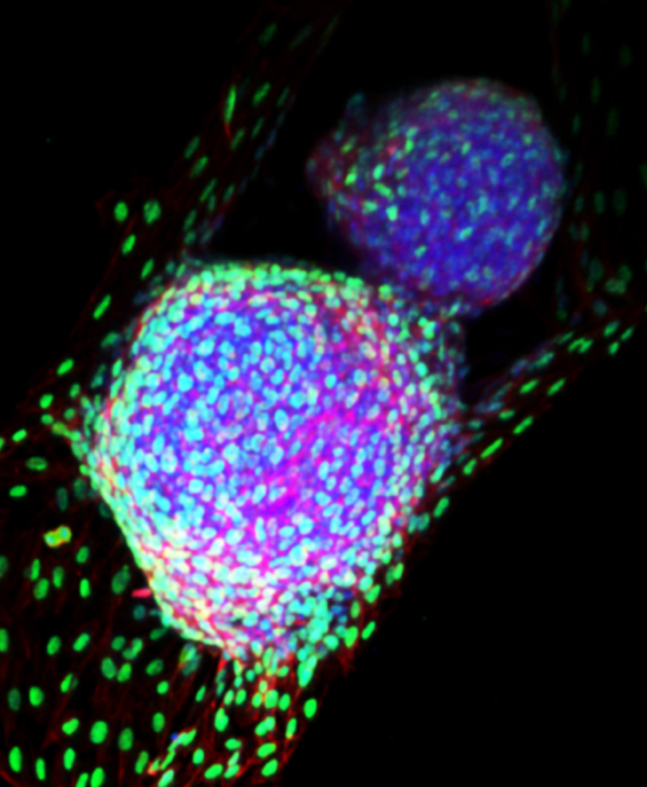

NICHD Strategic Plan: Research Themes
Understanding the Molecular, Cellular, and Structural Basis of Development
Promoting Gynecologic, Andrologic, and Reproductive Health
Setting the Foundation
for Healthy Pregnancies and Lifelong Wellness
Improving Child and Adolescent Health
and the Transition to Adulthood
Advancing Safe and Effective Therapeutics and Devices for Pregnant and
Lactating Women, Children, and People with Disabilities
Notes:
Notes for presenters:
The NICHD Strategic Plan focuses the institute’s research and training efforts to understand human development, improve reproductive health, enhance the lives of children and adolescents, and optimize abilities for all. It presents the institute’s research goals and objectives under five broad research themes.
These five themes will enable NICHD to focus its efforts on the most significant public health challenges and advance science in these areas of priority. The institute will measure progress toward these priorities; analyze the scientific, clinical, and public health impact of its research; and periodically report on metrics to stakeholders.
The plan also places special emphasis on better understanding male reproductive health and the challenges experienced by all adolescents during the transition to adulthood.

