Slide 1
NICHD Training and Career Development Implementation Working Group: Progress Update
NACHHD Council Presentation
June 3, 2024

Slide 2
Outline
Background Information
Implementation Working Group (WG)
Implementation WG Progress
Request for Information (RFI) Results

Slide 3
Background Information

Slide 4
Extramural Training and Career Development Working Group Background
When: The NICHD Extramural Training and Career Development Working Group (TCD WG) was created in January 2023.
Why: To help NICHD identify opportunities for its extramural training and career development programs to prepare the future research workforce to address NICHD’s mission.
The TCD WG met from January 2023 to December 2023 to develop six recommendations and 32 associated action items across three key areas:
Pre- and post-doctoral (F, T, Supplement) programs
Career development (K) programs
Alignment of training and career development goals with strategic priorities

Slide 5
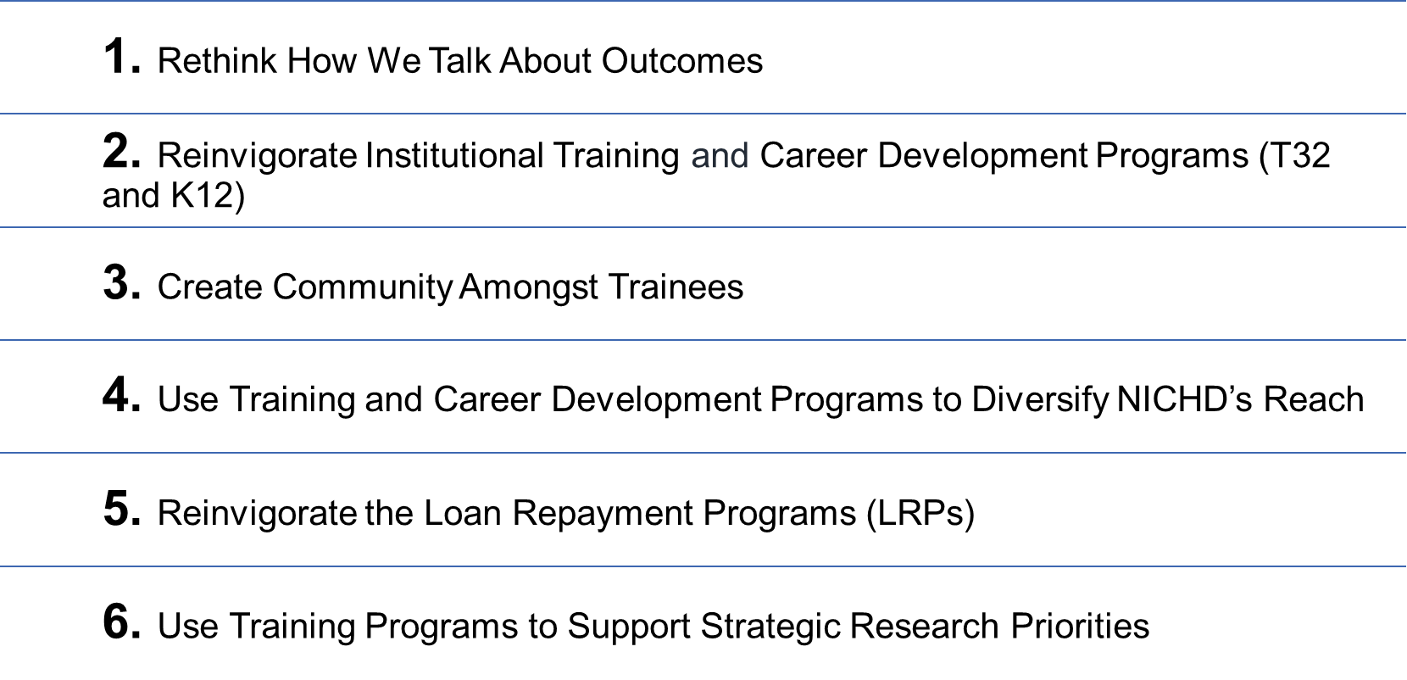
Summary of Recommendations

Slide 6
Implementation Working Group

Slide 7
Current State
January 22, 2024: The TCD WG Co-Chairs presented their recommendations and action items to the NACHHD Council and received approval to begin implementation efforts.
February 2024: A spinoff of the TCD WG, the DER/DEA TCD Implementation WG, was formed to support implementation of the recommendations and action items. The TCD Implementation WG was also tasked with releasing an RFI soliciting comments on the recommendations and action items presented to Council.
June 2024: The TCD Implementation WG is continuing work and is comprised of 20 members, including three Co-Chairs, and is organized into the following Subgroups:
Subgroup A:
Strategic Priorities, Outcomes, and Loan Repayment
Subgroup B:
Community and Diversity
Subgroup C:
Institutional Training and Career Development Programs (T32 and K12)

Slide 8
DER/DEA TCD Implementation WG Members
A huge thank you to our WG members and additional collaborators for their time and input!
Strategic Priorities, Outcomes & Loan Repayment
Community and Diversity
Institutional Training & Career Development (T32 and K12)
Subgroup A
Tessie October (Co-Chair & Lead A) Medical Officer, PTCIB
Brett Miller Deputy Branch Chief, CDBB
Chris Belter Program Analyst, DER
Katie Stein Program Officer, DBCAB
Joe Bonner HSA/Program Officer, NCMRR
Amanda Sztein Program Analyst, DER
Steven Kaufman Medical Officer, CRB
Subgroup B
Joe Gindhart (Co-Chair & Lead B) Deputy Director, DEA
Leigh Allen Program Officer, CRB
Sujata Bardhan Program Director, IDDB
Parisa Parsafar Program Officer, OHE
Lesly Samedy-Bates Program Officer, OPPTB
Monica Longo Medical Officer, PPB
Subgroup C
Susan Taymans (Co-Chair & Lead C) Deputy Branch Chief, FIB
Denise Russo Deputy Branch Chief, MPIDB
Tracy King Medical Officer, CDBB
Ronna Popkin Program Director, PDB
Guillermina Girardi Health Scientist Program Officer, PPB
Christiane Robbins Scientific Review Officer, SRB
Dennis Twombly Deputy Director, OEP

Slide 9
Implementation Working Group Progress

Slide 10
Subgroup A Breakdown: Strategic Priorities, Outcomes, and Loan Repayment
Recommendations: 3
Rethink How We Talk About Outcomes
Reinvigorate the Loan Repayment Programs (LRPs)
Use Training Programs to Support Strategic Research Priorities
Action Items: 11
Accomplished (2)
Expand LRP programs to include the L32 - Clinical Research for Individuals from Disadvantaged Backgrounds (DLR mandate; NICHD joined Sep. 2023)
Diversify the team involved in the LRP selection process to include representation from OHE and the training committee team
In Progress (9)
Develop approaches and algorithms to track and encourage important career trajectories in the future and describe them all as valid and successful outcomes

Slide 11
Subgroup B Breakdown: Community and Diversity
Recommendations: 2
Create Community Amongst Trainees
Use Training and Career Development to Diversify NICHD’s Reach
Action Items: 11
Accomplished (1)
Recommend that OHE develop a systematic process for evaluating and signing on to diversity-focused training notices of funding opportunity (NOFOs)
In Progress (10)
Host an annual or biennial workshop with fellowship trainees at NICHD
Create a distribution list of scholars and fellows to advertise NICHD-wide events
Equitable outreach across institutions to increase the number of fellowship applications from institutions without a history of significant NIH funding

Slide 12
Subgroup C Breakdown: Institutional Training and Career Development Programs (T32 and K12)
Recommendations: 1
Reinvigorate Institutional Training and Career Development Programs (T32 and K12)
Action Items: 10
Accomplished (1)
Establish a differential payline for new vs. renewal programs
In Progress (9)
Cluster Type 1 and Type 2 T32s separately in peer review
Create metrics to determine when a K12 program has achieved its goal or to indicate that another tactic for growing a workforce should be attempted

Slide 13
Request for Information (RFI) Results

Slide 14
RFI Summary Statistics: Demographics
In February 2024, the TCD Implementation WG released an RFI inviting comments on NICHD’s strategic recommendations (submitted to Council) for the future of extramural research training and career development.
13
Total Responses
7 responses were submitted on behalf of individual(s)*:
8 Doctors of Medicine (MDs)/Professors
1 Doctor of Veterinary Medicine (DVM)/Professor
Groups and institutions represented:
3 Providing Institutions
6 Academic or Research Institutions
4 Special Interest Groups
*One response was submitted on behalf of three individuals
Notes:
3 Providing Institutions:
Cincinnati Children’s Hospital
Emory University Department of Pediatrics and Children’s Healthcare of Atlanta
UT Southwestern Medical Center
6 Academic or Research Institutions
University of Illinois College of Medicine
University of Iowa
University of Utah School of Medicine
University of Colorado School of Medicine
Duke University School of Medicine
University of Michigan
4 Special Interest Groups:
People for the Ethical Treatment of Animals
Coalition for Pediatric Medical Research
Clinical Pharmacology Training Program Directors
NICHD-funded Pediatric Trials Network

Slide 15
RFI Summary Statistics: Recommendations Referenced
Notable Findings
The training and career development recommendation, “Reinvigorate Institutional Training and Career Development Programs (T32 and K12)”, was referenced in all but one RFI response
All training and career development recommendations were referenced in three or more RFI responses

Slide 16
RFI: Key Themes
Rethink How We Talk About Outcomes
Consider a broader spectrum of metrics when determining a successful research career
Example(s) included: Continued funding from any external source, careers in research-related positions, involvement in team science as a co-investigator, leadership positions outside of academics, mentoring success
Reinvigorate Institutional Training and Career Development Programs (T32 and K12)
Capitalize upon the benefits of partnership and collaboration
Examples included:
Expand upon partnership models already in place at NICHD
Partnerships with T32/K12 institutions and smaller/less resourced institutions to get broader involvement
Pair new/emerging programs with successful longstanding programs
Leverage the wealth of existing expertise across physician scientist training programs
Create Community Amongst Trainees
Provide extra support for the transition period from K to R
Use formal, funded opportunities to bring trainee community together
Rationale included: Funded retreats for networking and career development can be powerful for creating community
Reinvigorate the Loan Repayment Programs
Increase LRP review and selection process transparency
Use Training and Career Development to Support Strategic Research
Link K12/T32 programs to existing networks
Incentivize training programs to emphasize multidisciplinary and team science components
Note: This is not an exhaustive list. Only RFI response themes designated as potentially actionable by WG Co-Chairs are included.

Slide 17
Any Questions? Thank you!

